Slide 1
Presentation brief for MCT’s
Title of presentation | Integrate data from Notebooks with Azure Data Factory or Azure Synapse Pipelines
Presentation\Lab length | Presentation: 30 – 40 minutes Lab: 40 – 50 minutes
Audience | Data Professionals, Data Architects, Business Intelligence Professionals, Developers
Purpose | Understand how to add an activity to the control flow to orchestrate data from other technologies How parameters can be used in Azure Data Factory/Synapse pipelines
(think) Student key takeaways | The student should understand that Azure Data Factory/Synapse pipelines can work with other services The student should understand how dependency conditions are used in control flow The student should know what a parameter is and how it can be used in Azure Data Factory/Synapse pipelines
(feel) Student desired mindset | The student should feel that they can integrate other services into Azure Data Factory/Synapse pipelines The student may feel that in learning about parameters, there is greater flexibility in creating ETL solutions
(do) Student outcomes | The student should be able work with dependency conditions in control flow confidently The student should be able to articulate the role parameters play in pipelines
More information | For MCT course feedback, visit the Microsoft Official Courseware forum
Notes:
Instructor notes and guidance.
This slide is for MCT use only, outlining the aims and objectives of this module.

Slide 2
DP-203T00:
Integrate data from Notebooks with Azure Data Factory or Azure Synapse Pipelines
Notes:
Instructor notes and guidance.
In this module, explain to the students that they will learn how Azure Data Factory/Synapse Pipelines can orchestrate large scale data movement by using other Azure Data Platform and Machine Learning technologies. Stress to the students that this enables them to take advantage of the capabilities of other Azure Data Platforms to manipulate data rather than using the built-in capabilities of Azure Data Factory/Azure Synapse Pipelines (ADF/ASP) including the copy activity and the mapping data flow covered in the previous modules.
The reason for taking this approach is varied. Some organization may already have data engineering investments in other technologies that they would like to take advantage of. It could be that Azure Data Factory/Azure Synapse Pipelines does not have the capabilities that are required within the pipeline. At a simple level, you may have a team of data engineers that simply have a preference for using a specific technology. Regardless of the reason, this module explores how you can take advantage of Azure Data Factory/Azure Synapse Pipelines to orchestrate the pipeline that involves other Data Platform technologies. As a result, you need to be familiar with the Azure Data Factory/Azure Synapse Pipelines Control Flow component and how parameters can be used within them.
Share with the students that Azure Data Factory/Azure Synapse Pipelines can work with a wide variety of data platform technologies from Azure Machine Learning through to Azure Functions. In this module and the associate lab, share that you will explore how we can orchestrate notebooks as that is a common tool used by data engineering.

Slide 3

Agenda
Lesson 01 – Integrate data from Notebooks with Azure Data Factory or Azure Synapse Pipelines
Notes:
Instructor notes and guidance.
This space has been left deliberately blank.

Slide 4
Lesson 01: Integrate data from Notebooks with Azure Data Factory or Azure Synapse Pipelines
Notes:
Instructor notes
This space has been left deliberately blank

Slide 5
Integrating data from Notebooks with Azure Data Factory or Azure Synapse Pipelines
1.
Use Storage
Account
2.
Use Azure
Synapse Pipeline
3.
Create data
workflow
pipeline
4.
Add a Notebook
Activity to the
pipeline
5.
Set parameters
& dependency
conditions
Notes:
Talking points
The attendees should already be familiar with the first three steps of creating a storage account, creating Azure Data Factory/Synapse Pipelines, and creating a data workflow activity using a Copy Activity.
Focus on steps 4 and 5 which are focused on Azure Synapse Analytics Spark pools.
Instructor notes and guidance.
Call out to the students that step 4 can involve other technologies such as Azure Databricks notebooks.
Recommended reading for this slide
Orchestrating data movement and transformation in Azure Data Factory - Learn | Microsoft Docs

Slide 6
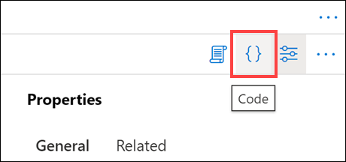
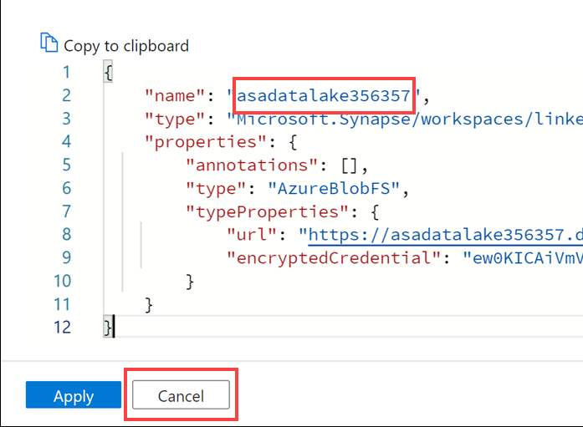
Programmatically creating Azure Data Factory or Azure Synapse Pipelines
Notes:
Talking points
When the students do the lab, call out that a couple of steps will involve building the data flows programmatically rather than through the UI. In the context of the course , this is purely for convenience as they have spent 90 minutes in the previous module building the same steps through a UI. However, it is worth pointing out that programmatically creating data flows is a method that could be used to build out ELT/ETL solutions
Instructor notes and guidance.
Use the example on the screen to talk students through an example of programmatically building a linked service, and share with the students that you can build solutions using Azure CLI, PowerShell, .NET, Python, REST API’s and ARM templates
Recommended reading for this slide
https://docs.microsoft.com/en-us/azure/data-factory/quickstart-create-data-factory-azure-cli
https://docs.microsoft.com/en-us/azure/data-factory/quickstart-create-data-factory-powershell
https://docs.microsoft.com/en-us/azure/data-factory/quickstart-create-data-factory-dot-net
https://docs.microsoft.com/en-us/azure/data-factory/quickstart-create-data-factory-python
https://docs.microsoft.com/en-us/azure/data-factory/quickstart-create-data-factory-rest-api
https://docs.microsoft.com/en-us/azure/data-factory/quickstart-create-data-factory-resource-manager-template

Slide 7
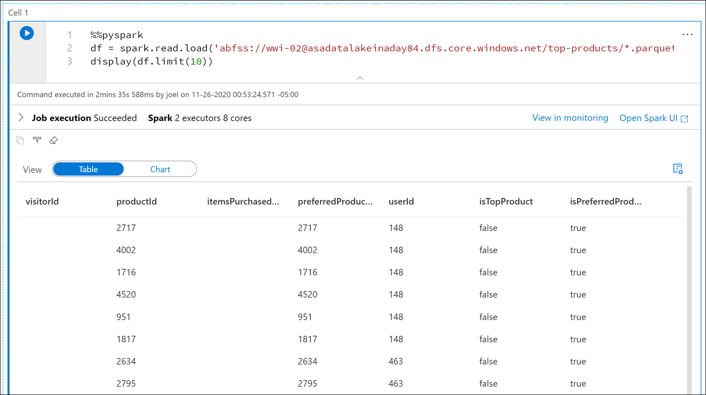
Create a notebook
Notes:
Talking points
You can take advantage of compute activities beyond what is available within Azure Synapse Analytics/Synapse pipelines. There are many example that include Azure Machine Learning, Azure Databricks, and Azure HDInsight. The example on the screen is that of a notebook that has been created in Azure Synapse Analytics Apache Spark pools
Instructor notes and guidance.
Remind the students that working with notebooks has already been covered in module 3 and 4, and that the focus here is how the notebooks can be integrated into an Azure Data Factory/Synapse Analytics pipeline
Recommended reading for this slide
https://docs.microsoft.com/en-us/learn/modules/orchestrate-data-movement-transformation-azure-data-factory/5a-exercise-integrate-notebook-azure-synapse-pipelines

Slide 8
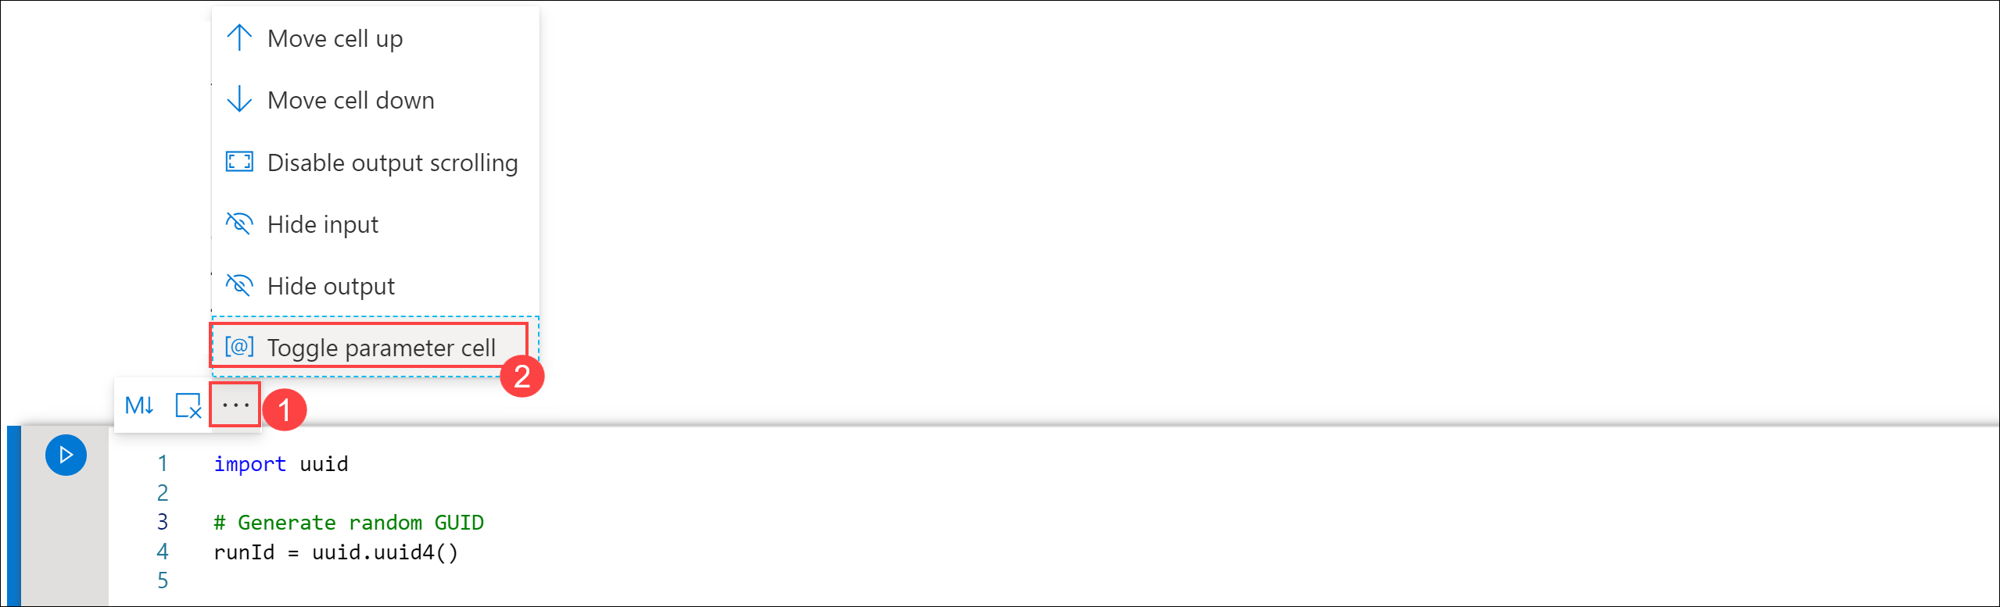
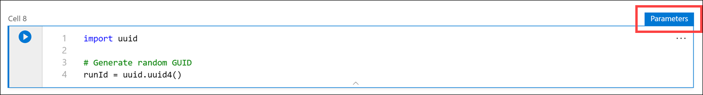
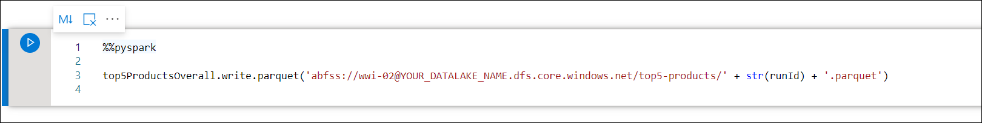
Create notebook parameters
Notes:
Talking points
Mapping data flows in Azure Data Factory and Azure Synapse Analytics support the use of parameters. Define parameters inside of your data flow definition and use them throughout your expressions. The parameter values are set by the calling pipeline via the Execute Data Flow activity. You have three options for setting the values in the data flow activity expressions:
Use the pipeline control flow expression language to set a dynamic value
Use the data flow expression language to set a dynamic value
Use either expression language to set a static literal value
Use this capability to make your data flows general-purpose, flexible, and reusable. You can parameterize data flow settings and expressions with these parameters.
If you are using this in conjunction with external resources; such as a notebook, you may want to parameterize values in a notebook and pass the notebook parameter value to parameters in a pipeline.
In the example in the slide, We are using the uuid library that comes with Spark to generate a random GUID. We want to override the runId variable with a parameter passed in by the pipeline. To do this, we need to toggle this cell in the notebook as a parameter cell. Then in a new cell to use the runId variable as the Parquet filename in the /top5-products/ path in the primary data lake account.
Instructor notes and guidance.
The students will see an example of passing parameter values from a notebook into a pipeline in the lab. Call out to students that there are many other example of how parameters can be used to help with enterprise data engineering solutions
Recommended reading for this slide
https://docs.microsoft.com/en-us/learn/modules/orchestrate-data-movement-transformation-azure-data-factory/5-add-parameters-components

Slide 9
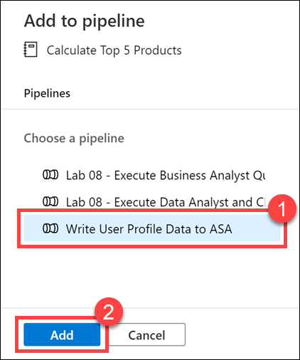
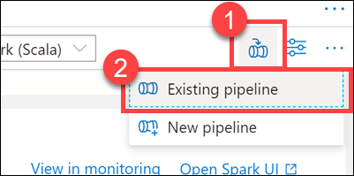
Integrating a notebook into a pipeline
Notes:
Talking points
If you are creating notebooks with the Apache Spark pools that exist in Azure Synapse Analytics, there is an integration feature at the top right of a notebook that enables you to add the notebook to an existing pipeline, or to use it as a basis of a new pipeline. You can also add notebook from Azure Databricks if that is the preference of your team.
Instructor notes and guidance.
Consider demonstrating this feature to the students with an existing notebook from a previous lab
Recommended reading for this slide
https://docs.microsoft.com/en-us/azure/data-factory/transform-data-databricks-notebook

Slide 10
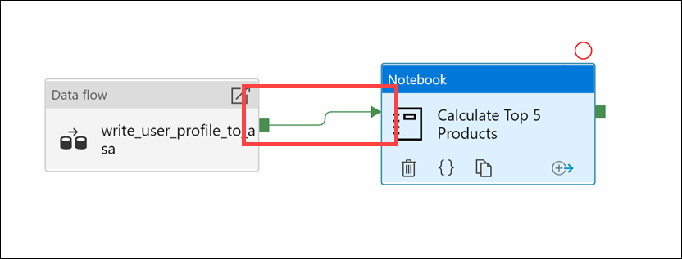
Controlling notebook execution in a pipeline
Notes:
Talking points
You can control the execution of the various components that reside within a pipeline through the branching and chaining of activities. A simple example can include a pipeline that does a simple copy from a container in Azure Blob Storage to another container in the same storage account. If the copy activity succeeds, the pipeline sends details of the successful copy operation (such as the amount of data written) in a success email. If the copy activity fails, the pipeline sends details of copy failure (such as the error message) in a failure email. IN the screen is an example of an activity named “write_user_profile…” that on success will then execute a notebook activity.
Instructor notes and guidance.
There are four types of output that can be defined on an activity including:
Success
Failure
Completion
Skipped
Recommended reading for this slide
https://docs.microsoft.com/en-us/azure/data-factory/tutorial-control-flow-portal

Slide 11
Review questions
Q01 – Which control flow setting allows you to pass arguments while you're invoking the pipeline?
A01 – Parameter
Q02 – There are four dependency conditions that link control flow activities together. Success, Failed, Completed. What is the fourth?
A02 – Skipped
Q03 – What type of parameter should you use when you have multiple pipelines where the parameters names and values are identical?
A03 – Global parameters
Notes:
Instructor notes and guidance.
This space has been left deliberately blank

Slide 12
Lab: Integrate data from Notebooks with Azure Data Factory or Azure Synapse Pipelines
Notes:
Instructor notes and guidance.
This space has been left deliberately blank

Slide 13
Lab overview
In the lab, the students will create a notebook to query user activity and purchases that they have been made in the past 12 months. They will then add the notebook to a pipeline using the new Notebook activity and execute this notebook after the Mapping Data Flow as part of their orchestration process. While configuring this, the students will implement parameters to add dynamic content in the control flow and validate how the parameters can be used.
Lab objectives
After completing this lab, you will be able to:
Integrate data from Notebooks with Azure Data Factory or Azure Synapse Pipelines
Notes:
Instructor notes and guidance.
In exercise 1 of this lab, the students will create a notebook, and there is an argument that this exercise is not relevant to the objective of the module which would be a fair comment. As a development team, we decided to keep this exercise on the basis that we received overwhelming feedback from MCTs that they wanted the course to have each module independent from each other. As a result, exercise 1 has been retained so that you can teach this module in isolation so that the students understand exactly what the notebook is doing, and how the parameter in the notebook will be used in exercise 2. Furthermore, it has removed a dependency on teaching Module 5 and 6 should you wish to tailor the course.
By creating the notebook in exercise 1, they then manage the orchestration of this notebook in an existing pipeline in exercise 2. This allows students to experience working with control flow, managing the flow and working with parameter to add dynamic capabilities to the pipelines that are built. The students will then execute the pipeline that they have modified with this orchestration to view the impact of the work that they create. It’s important to reinforce to the students the regular use of parameters in enterprise grade ETL solutions.

Slide 14











Lab 09 Overview
asacosmosdb<unique_suffix>
CosmosDB
Campaign Info
Azure Databricks
asagadatalake<unique_suffix>
Cluster
Azure Data Lake
wwi-02
Products (parquet)
dp203sql<unique_suffix>
SourceDB
Azure Synapse Analytics
Dedicated SQL Pool (SQLPool1)
Built-In Serverless SQL Pool
Apache Spark pool
Pipelines and
Dataflows
Power BI
asagaworkspace<unique_suffix>
Notes:
This slide is an optional slide that you can use to show a high-level overview of the technologies used in the lab.
In the lab, the students will create a notebook to query user activity and purchases that they have made in the past 12 months. They will then add the notebook to a pipeline using the new Notebook activity and execute this notebook after the Mapping Data Flow as part of their orchestration process. While configuring this the students will implement parameters to add dynamic content in the control flow and validate how the parameters can be used.

Slide 15
Lab review
Question 1 – Which Spark library is used to generate a random GUID?
Question 2 – What color is the Success dependency condition?
Question 3 – Which tab enables you to add dynamic content?
Question 4 – Where can you view information about a pipeline execution?
Notes:
Answers
Question 1 – The library uuid that comes with Spark is used to generate a random GUID
Question 2 – Green
Question 3 – The settings tab of a control flow activity allows you to add dynamic content
Question 4 – You can view the execution information in the pipeline runs in Azure Data Factory, when used in Azure Synapse Analytics, this is found in the monitor hub of Azure Synapse Studio

Slide 16
Module summary
In this module, you have learned about:
Integrate data from Notebooks with Azure Data Factory or Azure Synapse Pipelines
Next steps
After the course, consider watching the video on channel 9 that provides a summary of performing [Iterative development and debugging with Azure Data Factory]. Note that the content in this video also applies to Azure Synapse Pipelines too.
Notes:
Instructor notes and guidance.
The next steps is suggested post course learning materials to reinforce what they have learned in the module.

Slide 17
Closing slide
Notes:
Instructor notes and guidance.
This space has been left deliberately blank

